Slide 1
Simulation and Modeling
CSE4131_CSE4132

Slide 2
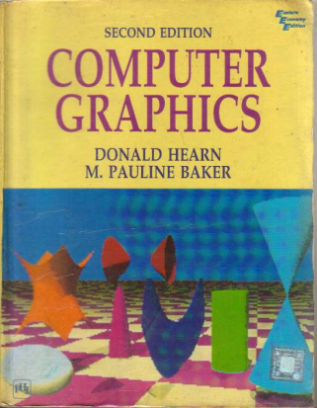
Reference Book
Computer Graphics (2nd Edition)
D. HEARN
M. P. BAKER

Slide 3
Spline Specifications
There are three equivalent methods for specifying a particular spline representation:
We can state the set of boundary conditions that are imposed on the spline;
We can state the matrix that characterizes the spline;
We can state the set of blending functions (or basis functions) that determine how specified geometric constraints on the curve are combined to calculate positions along the curve path.

Slide 4
Some Commonly Used Splines
Some commonly used splines and their matrix and blending-function specifications
Cubic Spline Interpolation Method
Natural Cubic Splines
Hermit Spline
Cardinal Splines
Kochanek-Bartels Splines

Slide 5
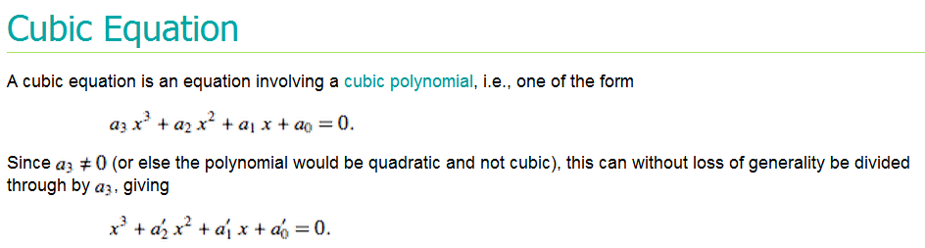
Cubic Spline Interpolation Method
This class of splines is most often used to:
set up paths for object motions or
to provide a representation for an existing object or drawing, +
also used sometimes to design object shapes.
Cubic polynomials offer a reasonable compromise between flexibility and speed of computation.
Compared to higher-order polynomials, cubic splines require less calculations and memory and they are more stable.
Compared to lower-order polynomials, cubic splines are more flexible for modeling arbitrary curve shapes

Slide 6

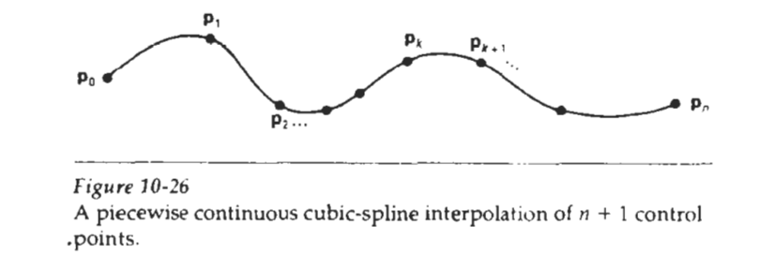
Cubic Spline Interpolation Method
Given a set of control points,
cubic interpolation splines are obtained by fit ting the input points with a piecewise cubic polynomial curve that passes through every control point.
Suppose we have n + 1 control points specified with coordinates
A cubic interpolation fit of these points is illustrated in Fig. 10-26

Slide 7
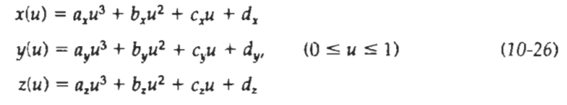
Cubic Spline Interpolation Method
We can describe the parametric cubic polynomial that is to be fitted between each pair of control points with the following set of equations:
For each of these three equations, we need to determine
We do this by the values of the four coefficients a, b, c, and d in the polynomial representation for each of the n curve sections between the n + 1 control points.

Slide 8
Natural Cubic Splines
One of the first spline curves to be developed for graphics applications is the natural cubic spline.
This spline interpolation curve is a mathematical representation of the original drafting spline.
We formulate a natural cubic spline by requiring that
two adjacent curve sections have the same first and second parametric derivatives at their common boundary.
Thus, natural cubic Splines have C² continuity.

Slide 9
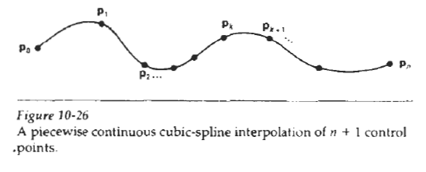
Cubic Spline Interpolation Method
We can describe the parametric cubic polynomial that is to be fitted between each pair of control points with the following set of equations:
For each of these three equations, we need to determine
We do this by the values of the four coefficients a, b, c, and d in the polynomial representation for each of the n curve sections between the n + 1 control points.
We do this by setting enough boundary conditions at the "joints" between curve sections so that we can obtain numerical
values for all the coefficients.

Slide 10
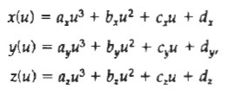
Natural Cubic Splines
If we have n + 1 control points to fit,
then we have n curve sections
with a total of 4n polynomial coefficients to be determined.
4 polynomial coefficients
P(u)=au³+bu²+cu+d

Slide 11
Natural Cubic Splines
At each of the n - 1 interior(inner) control points, we have four boundary conditions:
The two curve sections on either side of a control point must have the same first and second parametric derivatives at that control point, and
Each curve must pass through that control point.
This gives us 4n -4 equations to be satisfied by the 4n polynomial coefficients.
1st derivative of p₀p₁at p₁= value
2nd derivative of p₀p₁at p₁= value
1st derivative of p₁p₂ at p₁= value
2nd derivative of p₁p₂at p₁= value

Slide 12
Natural Cubic Splines
We get
an additional equation from the first control point p₀ , the position of the beginning of the curve, and
Another condition from control point p_{n} which must be the last point on the curve.
We still need two more conditions to be able to determine values for all coefficients. (To solve for n unknown variables, we need at least n equations)
One method for obtaining the two additional conditions is to set the second derivatives at p₀ and p_{n} to 0.

Slide 13
Natural Cubic Splines
Another approach is to add two extra "dummy" control points, one at each end of the original control-point sequence.
That is, we add a control point p₋₁ and a control point p_{n+1}, Then all of the original control points are interior points, and we have the necessary 4n boundary conditions.
Disadvantage.
If the position of any one control point is altered, the entire curve is affected. Thus, natural cubic Splines allow for no "local control", so that we cannot restructure part of the curve without specifying an entirely new set of control points.

Slide 14
Hermite Interpolation
Named after French Mathematician Charles Hermite
Hermite Interpolation is an interpolating piecewise cubic polynomial with a specified tangent at each control point.
Unlike the natural cubic Splines, Hermite splints can be adjusted locally
because each curve section is only dependent on its endpoint constraints.

Slide 15
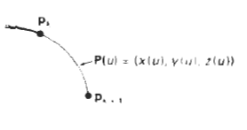
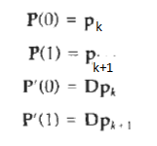
Hermite Interpolation
If P(u) represents a parametric cubic point function for the curve section between control points p_{k} and p_{k+1}
Then the boundary conditions that define this Hermite curve section are:
Eq. 10.27
with Dp_{k} and Dp_{k+1},spcifying the values for the parametric derivatives (slope of the curve) at control points p_{k} and p_{k+1}respectively.

Slide 16
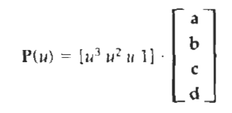
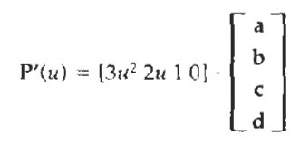
Hermite Interpolation
We can write the vector equivalent of Eqs. 10-26 for this Hermite-curve section as:
P(u)=au³+bu²+cu+d
Eq. 10.28
Where x component of P is x(u)=au³+bu²+cu+d
The matrix equivalent should be:
Eq. 10.29
The derivative of the point function can be expressed as:
Eq. 10.30

Slide 17
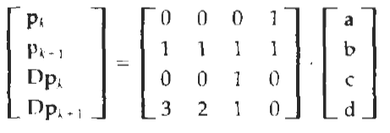
Hermite Interpolation
Substituting endpoint values 0 and 1 for parameter u into the previous two equations, we can express the Hermite boundary conditions 10-27 in the matrix form:
Eq. 10.27
Eq. 10.30
Eq. 10.28
P(u)=au³+bu²+cu+d
Put u=0

Slide 18
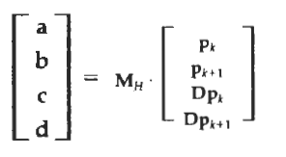
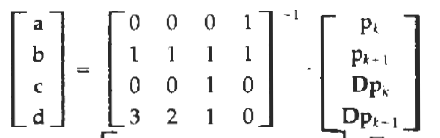
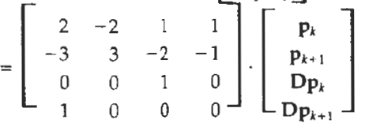
Hermite Interpolation
For matrix calculation: http://www.bluebit.gr/matrix-calculator/
where M_{H} the Hermite matrix, is the inverse of the boundary constraint matrix.

Slide 19
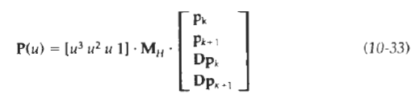
Hermite Interpolation
Equation 10-29 can thus be written in terms of the boundary conditions as

Slide 20
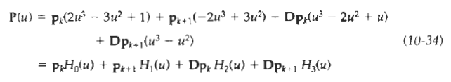
Hermite Interpolation
Finally, we can determine expressions for the Hermite blending functions by carrying out the matrix multiplications in Eq. 10-33 and collecting coefficients for the boundary constraints to obtain the polynomial form:
The polynomials H_{k}(u) for k = 0, 1, 2, 3 are referred to as blending functions because they blend the boundary constraint values (endpoint coordinates and slopes) to obtain each coordinate position along the curve.

Slide 21
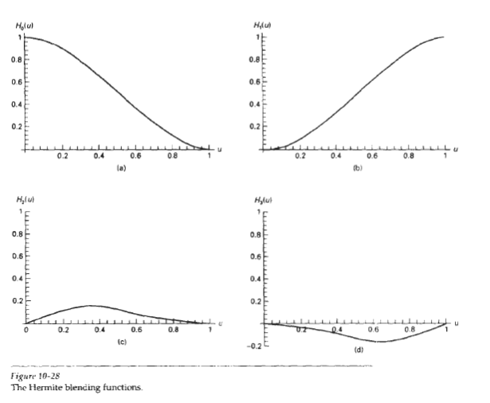
Hermite Interpolation

